Slide 1

Online Book Dataset Analysis Using Web Scraping
J. Srivalli Janani
81020512826
Batch 543

Slide 2
About me
Background?
I completed my B.Tech in Data Science from Sreyas Institute of Engineering and Technology.
Why you want to learn Data Science
I want to learn Data Science because it helps solve real-world problems by analyzing data and making informed decisions.
Any work experience
I completed Data Analyst Intern Internship at Greenko Energies Private Limited where I gained hand-on experience in Python, SQL, Data analysis and preprocessing and working with real-time datasets.
Share your LinkedIn and GitHub profile URLs
www.linkedin.com/in/srivallijanani
https://github.com/Srivalli-04

Slide 3
Agenda
Business Problem
Problems Statement
Objective of the project
Introduction
Dataset Description
EDA Overview
EDA Analysis
Key Insights
Conclusion
Recommendations
Questions & Answers

Slide 4
INTRODUCTION
The Online Book Dataset Analysis project focuses on collecting and analyzing book-related information from the Books to Scrape website. The project uses Python, Requests, and BeautifulSoup to extract details such as book title, price, rating, availability, and category. The collected data is cleaned and organized using Pandas, followed by exploratory data analysis using Matplotlib and Seaborn. The analysis helps identify patterns in book prices, ratings, category distribution, and availability, converting raw web data into meaningful insights.

Slide 5
Business Problem
Collecting book information manually from multiple web pages is time-consuming.
Book details such as price, rating, and availability need to be organized for analysis.
Unstructured information makes comparisons between book categories difficult.
A structured dataset can help identify pricing patterns and catalogue characteristics.

Slide 6
BUSINESS STATEMENT
The project aims to collect book information from an online catalogue, organize it into a structured dataset, and analyze the collected data to understand book prices, ratings, categories, and availability.
The analysis uses Python-based web scraping, data cleaning, and exploratory data analysis to identify meaningful patterns in the collected records.

Slide 7
OBJECTIVE OF THE PROJECT
To collect 1,000 book records from an online book catalogue.
To extract relevant book information using Python.
To clean and prepare the collected dataset for analysis.
To explore price, rating, category, and availability patterns.
To represent findings through suitable statistical visualizations.

Slide 8
EDA OVERVIEW
Attribute | Details
Data Source | Books to Scrape website
Data Collection Method | Web Scraping
Total Records | 1,000 books
Total Attributes | 6 columns
Data Type | Structured tabular data
Programming Language | Python
Data Processing | Pandas
Analysis Method | Exploratory Data Analysis (EDA)
Visualization Tools | Matplotlib and Seaborn
Currency | British Pounds (£)

Slide 9
Key Fields Extracted
Title: The official name of the book extracted from the book listing page.
Price: The selling price of the book, extracted in British Pounds (£) and later converted into a numerical format for analysis.
Rating: The customer rating of the book, represented on a 1 to 5 star scale and converted into numerical values for analysis.
Availability: The current stock status of the book, indicating whether the book is in stock.
Category: The category or genre assigned to the book, used for category-wise analysis and comparison.
Product URL: The direct URL of the individual book page, useful for identifying and referencing the source of each book record.

Slide 10
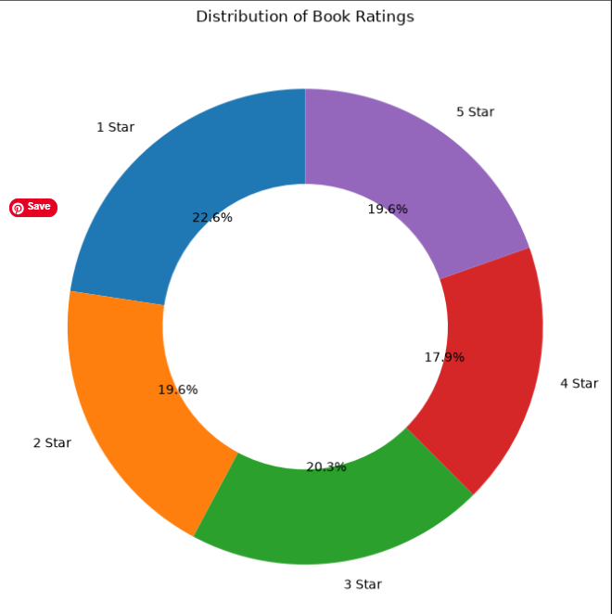
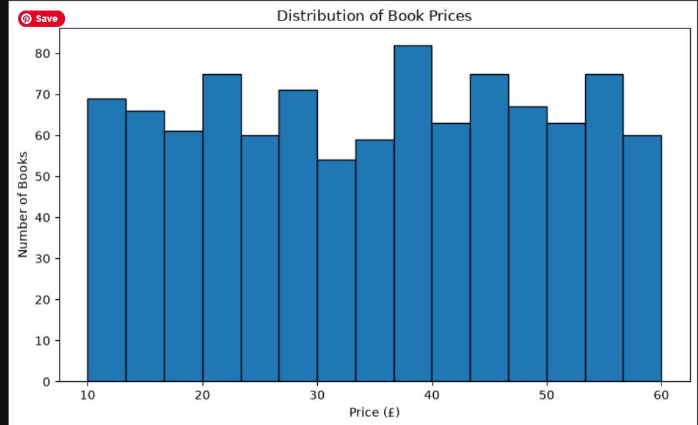
EDA ANALYSIS
Univariate Analysis
Insight:
The donut chart shows the distribution of books across rating levels from 1 to 5 stars.
It helps identify which rating levels are most common in the dataset.
This analysis provides an overview of how books are rated in the online catalogue.
The bar chart shows the distribution of books across different categories in the dataset.
Categories with taller bars contain more books, while shorter bars represent fewer books.
This analysis helps identify which categories are most represented in the collected catalogue of 1,000 books.

Slide 11
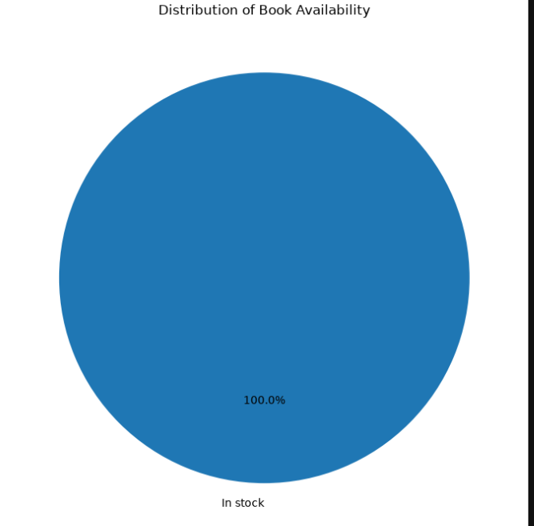
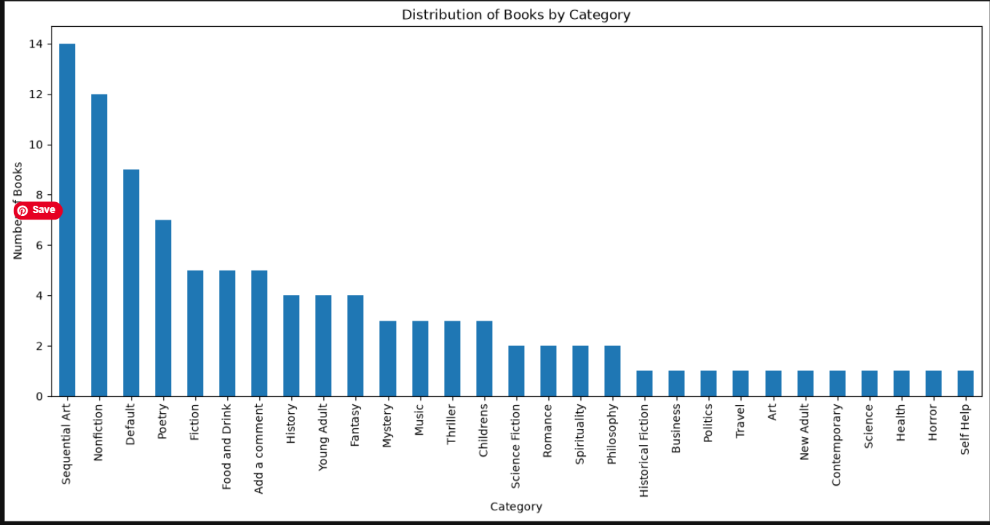
Insight:
The pie chart shows the proportion of books that are in stock and out of stock.
It helps understand the availability status of books in the collected dataset.
This analysis provides an overview of book availability in the online catalogue of 1,000 books.
Insight:
Shows the number of books available in each category.
Helps identify categories with higher and lower representation.
Provides an understanding of the category distribution within the collected dataset.

Slide 12
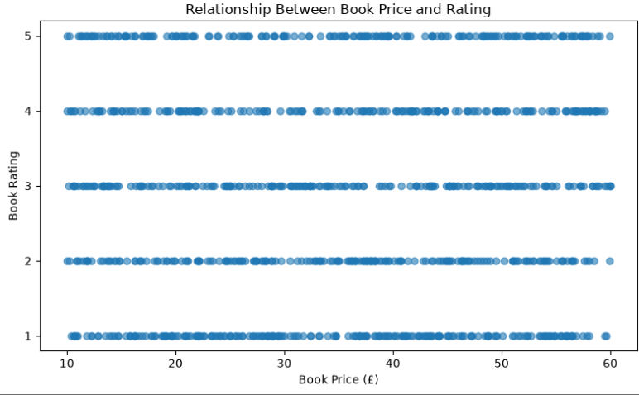
Bi-Variate Analysis
The scatter plot shows the relationship between book prices and their ratings.
It helps examine whether books with higher prices tend to receive higher ratings.
The distribution of points reveals variations in book prices across different rating levels

Slide 13
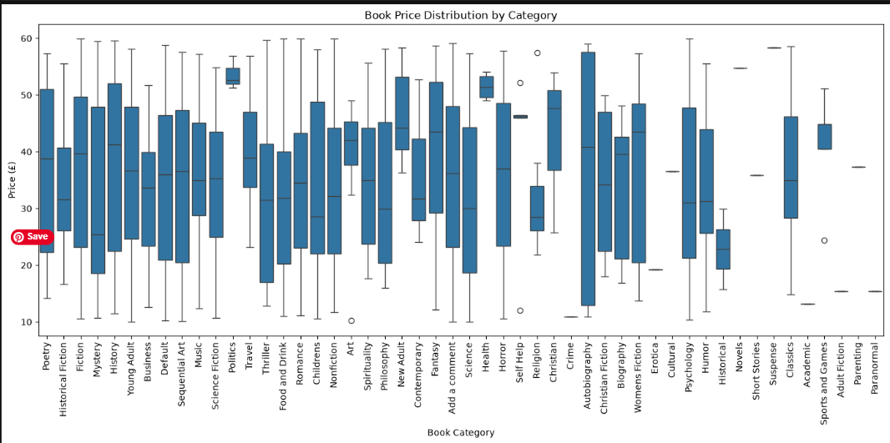
The box plot compares the price distribution of books across different categories.
It helps identify categories with higher or lower price ranges.
The plot highlights variations in book prices and identifies potential price outliers.

Slide 14
Hypothesis testing
Objective: To determine whether the average rating of books differs significantly from 4.0.
Null Hypothesis (H₀): The average book rating is equal to 4.0.
Alternative Hypothesis (H₁): The average book rating is not equal to 4.0.
Test Used: Two-tailed one-sample t-test
Significance Level: 5% (α = 0.05)
Decision Rule:
If the p-value < 0.05, reject H₀.
If the p-value ≥ 0.05, fail to reject H₀.
Conclusion: The decision will be based on the p-value calculated from the actual book ratings in the dataset.

Slide 15
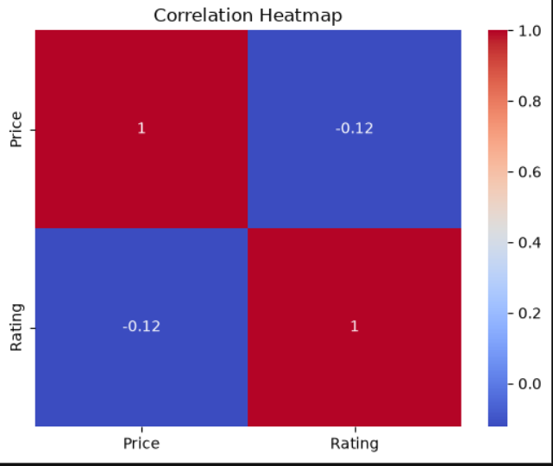
Multivariate Analysis
Insight:
Shows the correlation between the numerical variables Price and Rating.
Helps understand the strength and direction of the relationship between price and rating.
A value closer to +1 indicates a strong positive relationship, while a value closer to -1 indicates a strong negative relationship.
A value close to 0 indicates a weak or no linear relationship.

Slide 16
KEY INSIGHTS
Dataset Coverage: Successfully collected 1,000 book records across six attributes.
Category Distribution: Identifies the most represented book categories in the online catalogue.
Book Availability: Shows the distribution of books that are in stock and out of stock.
Rating Distribution: Highlights the most common book rating levels.
Price vs. Rating: Examines the relationship between book prices and ratings.
Price by Category: Compares price ranges across categories and identifies potential outliers.

Slide 17
CONCLUSION
The Online Book Dataset Analysis project successfully collected 1,000 book records from the Books to Scrape website and transformed them into a structured dataset for analysis. The project explored book characteristics such as price, rating, category, and availability to identify meaningful patterns. Univariate and bivariate analyses helped examine individual data distributions and the relationship between book prices and ratings. Overall, the project demonstrates how web scraping, data cleaning, and exploratory data analysis can convert raw online book data into meaningful insights.

Slide 18
RECOMMENDATIONS
Based on the analysis, online bookstores can use book price, rating, category, and availability data to better understand their catalogue. Categories with a larger number of books can be monitored to maintain a balanced selection, while price comparisons across categories can support pricing decisions. Book ratings can help identify highly rated titles and understand customer preferences. Regularly updating book information through web scraping can also help maintain an organized and up-to-date dataset for future analysis.

Slide 19
Q & A

Slide 20

THANK YOU

